Slide 1
Lecture-1: LAN Devices

Slide 2
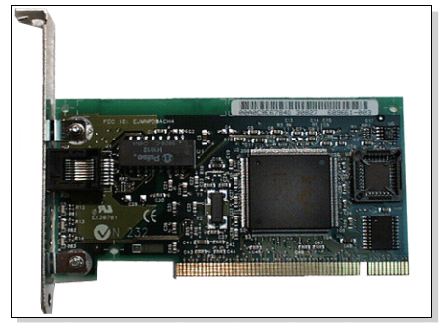
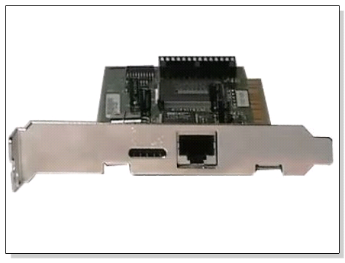
Network Interface Card
Also called Network Adapter
Connects a host to a network medium
Provides the physical interface between computer and cabling.
It prepares data, sends data, and controls the flow of data. It can also receive and translate data into bytes for the CPU to understand.
Contain unique MAC Address to control data communication
Transceiver may be used to connect to mismatched media type
Notes:
Network media is the actual path over which an electrical signal travels as it moves from one component to another.
Media type-> There are three general classes of media types: coaxial cable, twisted pair and fiber optic cable.
MAC address: media access control address

Slide 3
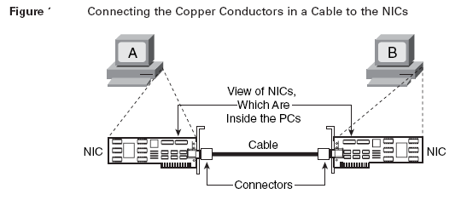

Slide 4
Network Devices
IEEE committee identified the following possible internetworking scenarios.
A single LAN
Two LANs connected together (LAN-LAN)
A LAN connected to a WAN (LAN-WAN)
Two LANs connected through a WAN (LAN-WAN-LAN)
Various internetworking devices such as repeaters, hubs, bridges, switches, routers and gateways are required to link them together.
Notes:
A LAN (local area network) is a group of computers and network devices connected together, usually within the same building.
A WAN connects several LANs, and may be limited to an enterprise (a corporation or an organization) or accessible to the public. The technology is high speed and relatively expensive. The Internet is an example of a worldwide public WAN.

Slide 5

Repeaters
Repeater is a powerful network device which is used to increase the length of the network by eliminating the effect of attenuation on the signal.
A single Ethernet segment can have a maximum length of 500 meters with a maximum of 100 stations. To extend the length of the network, a repeater may be used
The purpose of the Ethernet repeater is to carry signal from one Ethernet cable and take it to the other cable without attenuation or loss of signal strength.
A repeater exists as the first layer of the OSI layer that is physical layer.
Repeaters require a small amount of time to regenerate the signal. This can cause a propagation delay.
Notes:
Attenuation is the loss of signal strength in networking cables or connections. This typically is measured in decibels (dB) or voltage and can occur due to a variety of factors. It may cause signals to become distorted or indiscernible.
OSI Model=> Open Systems Interconnection Model

Slide 6
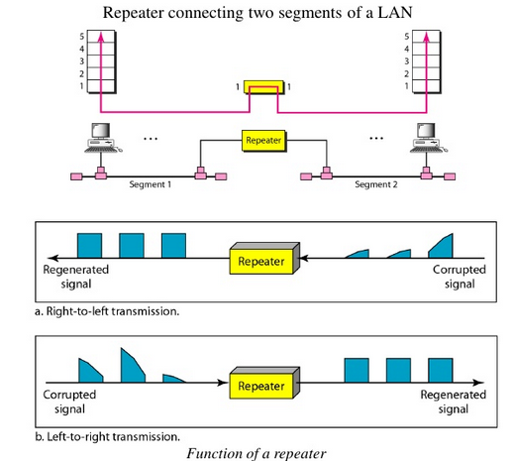
Repeaters

Slide 7
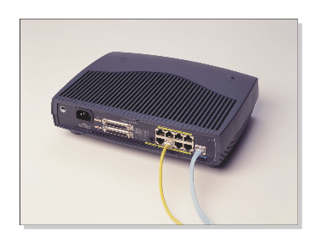
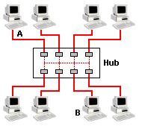
Hub
Multi-port repeaters with 4 to 24 ports (typical repeater usually has 2 ports)
It repeats what it receives on one port to all other ports, including the port on which the signal was received, so that the transmitting device may monitor and recover from collisions.
Converts the network to Star topology
Commonly used in 10Base-T and 100Base-T networks
Notes:
10Base-T (Ethernet) and 100Base-T (Fast Ethernet) refer to the performance capability of the Network Interface Card (NIC)
T-> Twisted
10Base-T has a rated transfer speed of 10 Megabits per second and
100Base-T is rated at 100 Megabits per second

Slide 8
Hub Types
Passive
Serves as a physical connection point only
Does not manipulate or view the traffic
Does not boost or clean the signal.
Used only to share the physical media
Does not need electrical power
Active
Needs electrical power to amplify signal
Intelligent Hub /Smart Hub
Contain Microprocessor chips and diagnostic capabilities
Enables an administrator to monitor the traffic passing through the hub and to configure each port in the hub.
Expensive

Slide 9
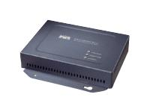
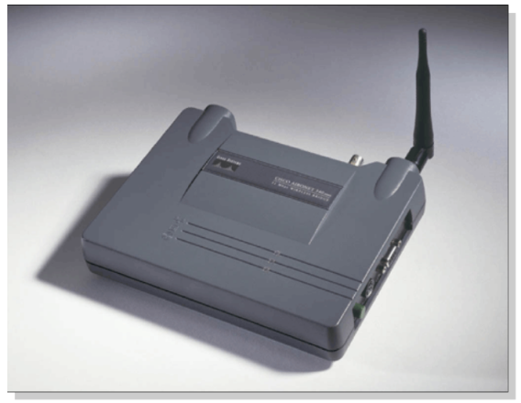
Bridges
The device that can be used to interconnect two separate LANs is known as a bridge.
It is commonly used to connect two similar or dissimilar LANs.
Operates in both the Physical Layer and the Data Link Layer.
As a Physical Layer device, it regenerates the signal it receives.
As a Data Link Layer device, the bridge can check the Physical/MAC addresses (source and destination) contained in the frame.

Slide 10
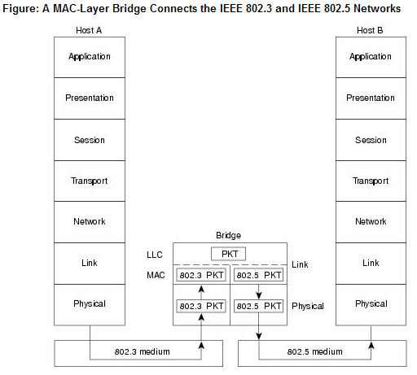
Translational Bridges
Notes:
The above figure illustrates an IEEE 802.3 host (Host A) formulating a packet that contains application information and encapsulating the packet in an IEEE 802.3-compatible frame for transit over the IEEE 802.3 medium to the bridge. At the bridge, the frame is stripped of its IEEE 802.3 header at the MAC sublayer of the link layer and is subsequently passed up to the LLC sublayer for further processing. After this processing, the packet is passed back down to an IEEE 802.5 implementation, which encapsulates the packet in an IEEE 802.5 header for transmission on the IEEE 802.5 network to the IEEE 802.5 host (Host B).
Logical Link Control (LLC) sublayer provides the logic for the data link; thus it controls the synchronization, flow control, and error-checking functions of the data link layer.

Slide 11
How Bridges Work?
A bridge has a table used in filtering decisions.
A bridge has a table that maps address to ports.
It can check the destination address of a frame and decide if the frame should be forwarded or dropped.
If the frame is to be forwarded, the decision must specify the port.
Bridges have three basic functions:
Forwarding a frame from one segment to another across the bridge.
Filtering a frame that does not need to cross the bridge to reach its destination.
Flooding a frame to all ports when the location of the destination address is unknown.
Increases network performance

Slide 12
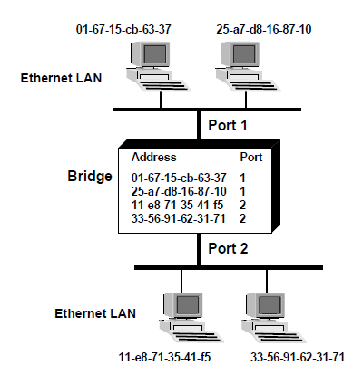
Transparent Learning Bridges Build Forwarding Tables
Notes:
The Basic Forwarding Process
When a bridge receives a frame, it compares the frame’s source and destination address with the addresses in the forwarding table. Depending on the results, the bridge performs the following actions:
• If the source address is not present in the forwarding table, the bridge adds the source address and corresponding interface to the table. It then checks the destination address to determine if it is in the table.
• If the destination address is listed in the table, it determines if the destination address is on the same LAN as the source address. If it is, then the bridge drops the frame since all the workstations have already received the frame.
• If the destination address is listed in the table but is on a different LAN than the source address, then the frame is forwarded to that LAN.
• If the destination address is not listed in the table, then the bridge forwards the frame to all the LANs except the one that which originally received the frame. This process is called flooding.

Slide 13
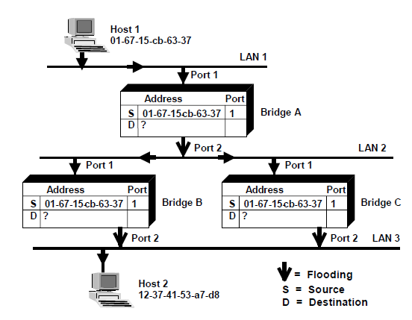
The Frame is Flooded Across the Network
Notes:
The Frame is Flooded Across the Network
1. Host 1 sends a frame out over LAN 1. Bridge A receives the frame on port #1.
2. Bridge A records the source address (01-67-15-cb-63-37) of the frame and the port number on which the frame was received (port 1).
3. Bridge A then looks for the destination address of the frame. If the destination address is not in the forwarding table prior to receiving the frame, the bridge floods the frame onto LAN 2.
4. Both Bridge B and Bridge C receive the frame. Both bridges record the source address and the port number on which the frame was received (port 1).
5. Since neither bridge has the destination address in their forwarding table they both flood the frame onto LAN 3. This results in two frames being sent onto LAN 3.
6. Host 2 receives the frame.

Slide 14
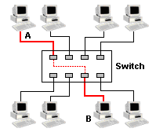
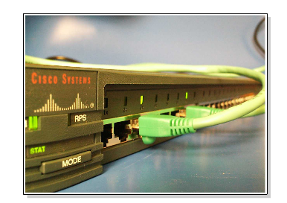
Switches
Sometimes called multiport bridge
A switch is essentially a fast bridge having additional sophistication that allows faster processing of frames.
Improves congestion and reduce traffic

Slide 15
Functions of Switch
Some of important functionalities are:
Ports are provided with buffer
Switch maintains a directory: #address - port#
Each frame is forwarded after examining the #address and forwarded to the proper port#
Three possible forwarding approaches: Cut-through, Collision-free and Fully-buffered.

Slide 16
Functions of Switch
Cut-through: A switch forwards a frame immediately after receiving the destination address. As a consequence, the switch forwards the frame without collision and error detection.
Collision-free: In this case, the switch forwards the frame after receiving 64 bytes, which allows detection of collision. However, error detection is not possible because switch is yet to receive the entire frame.
Fully buffered: In this case, the switch forwards the frame only after receiving the entire frame. So, the switch can detect both collision and error free frames are forwarded.

Slide 17
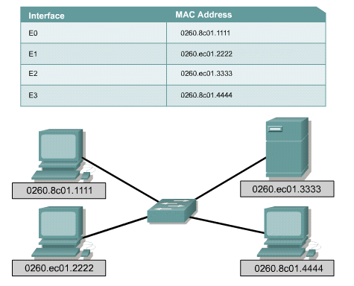
Switching Table

Slide 18
Advantages of Switch
Switches operate at much higher speeds than bridges
Can support new functionality, such as Virtual LANs.
Allows multiple users to communicate at the same time through Virtual circuits and dedicated network segments
Creates Virtually Collision free environment
Improves network speed, bandwidth and performance
Very cost effective since the hardware and cables in place can be reused

Slide 19
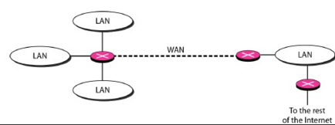
Router
Also called 3-layer switches
Routes packets based on their logical addresses (host-to-host addressing) .
A router normally connects LANs and WANs in the Internet and has a routing table that is used for making decision about the route.
The routing tables are normally dynamic and are updated using routing protocols.

Slide 20
Components of Router
A router has four basic components:
Input port performs physical and data-link layer functions of the router. Ports are also provided with buffer to hold the packet before forwarding to the switching fabric.
Output ports perform the same functions as the input ports, but in the reverse order.
The routing processor performs the function of the network layer. The process involves table lookup.
The switching fabric moves the packet from the input queue to the output queue by using specialized mechanisms. The switching fabric is realized with the help of multistage interconnection networks.

Slide 21
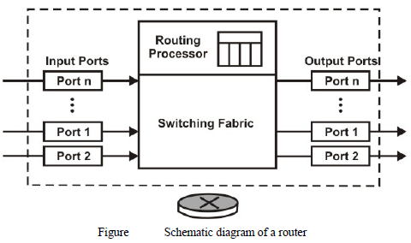
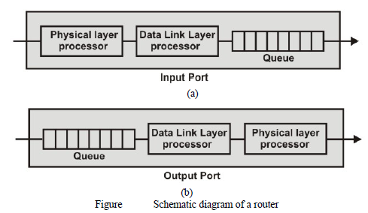

Slide 22
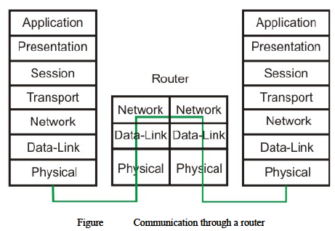

Slide 23
Gateway
A gateway is a hardware device that acts as a "gate" between two networks.
It may be a router, firewall, server, or other device that enables traffic to flow in and out of the network.
A router is a common type of gateway used in home networks. It allows computers within the local network to send and receive data over the Internet.
A firewall is a more advanced type of gateway, which filters inbound and outbound traffic, disallowing incoming data from suspicious or unauthorized sources.
A proxy server is another type of gateway that uses a combination of hardware and software to filter traffic between two networks. For example, a proxy server may only allow local computers to access a list of authorized websites.
Gateways can operate at all layers of the OSI model

Slide 24
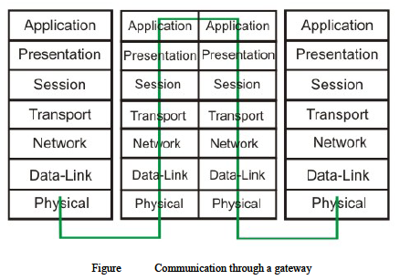
Notes:
Gateway A gateway is a node on a network that serves as an entrance to another network. The gateway routes traffic from a computer to an outside network that is serving the web pages. For example, the gateway for a home computer is the ISP provider that connects the user to the Internet. In a corporate environment, the gateway often acts as a proxy server and a firewall. Gateways are similar to routers and switches in that they forward data to the destination and provide the path for which the data will travel to the destination.

Slide 25
Ping
A ping is perhaps the most commonly used tool when troubleshooting a network.
Ping (Packet Internet Groper) tool is included with most operating systems. It is invoked using a ping command.
Ping command uses ICMP (Internet Control Message Protocol).
Ping works by sending an ICMP echo request message to the specified IP address.
If the computer with the destination IP address is reachable, it responds with an ICMP echo reply message.
Notes:
Cmd-> ping google.com

Slide 26
Traceroute
Traceroute is a CLI (Command-line interface)-based tool used to identify the path used by a packet to reach its target.
This tool also uses ICMP messages, but unlike ping, identifies every router in a path.
Traceroute is useful when troubleshooting network problems because it can help identify where exactly the problem is.
The traceroute command on Windows is named tracert.
Notes:
Cmd-> tracert google.com

Slide 27
IP Address and Host Name
IP Address (Internet Protocol address):
Also known as Logical Address, is the network address of the system across the network.
To identify each device in the world-wide web, Internet Assigned Numbers Authority (IANA) assigns IPV4 (Version 4) address as unique identifier for each device on the Internet.
Length of the IP address is : 32-bits. (Hence we have 2³² ip addresses available.)
Commands: C:\>ipconfig
Host Name:
Each device in the network is associated with a unique device name known as Hostname.
Commands: C:\Windows\System32>hostname

Slide 28
MAC Address
MAC Address (Media Access Control address):
Also known as physical address, is the unique identifier of each host and is associated with the NIC (Network Interface Card).
MAC address is assigned to the NIC at the time of manufacturing. Length of the MAC address is : 12-digit/ 6 bytes/ 48 bits.
ARP (Address Resolution Protocol) is used to convert the IP address to its corresponding MAC Address.
ARP is used by the Data Link Layer to identify the MAC address of the Receiver’s machine.
C:\>arp –a is used to discover what machines are directly connected to the host.

Slide 29
Port
Port can be referred as logical channel through which data can be sent/received to an application.
Any host may have multiple applications running, and each of this application is identified using the port number on which they are running on.
Port number is a 16-bit integer; hence we have 2¹⁶ ports available which are categorized as shown below:
Command to see active port C:\>netstat –a
The unique combination of IP address and Port number together are termed as Socket.
PORT TYPES | RANGE
Well known Ports | 0 – 1023
Registered Ports | 1024 – 49151
Ephemeral (Temporary) Ports | 49152 – 65535

Slide 30
DNS Server
DNS ( Domain Name System) is basically a server which translate web addresses or URL (ex: www.google.com) into their corresponding IP addresses.
The command ‘nslookup’ gives the IP address of the domain you are looking for. This also provides the information of our DNS Server.
Command: C:\Windows\System32>nslookup www.google.com

